Slide 1
Vglobal

Slide 2







www.vnavi.com
APP
Download
ABOUT US,Vbikes Misson & Goals
We are a New Age App Company ready to coupled with a eco system to establish more business opportunities.
Following the foot-step of the most successful business platform “Alibaba” and visonary Mr Jack Ma, VNavi aims to be new rookie in app industry globally.

Slide 3

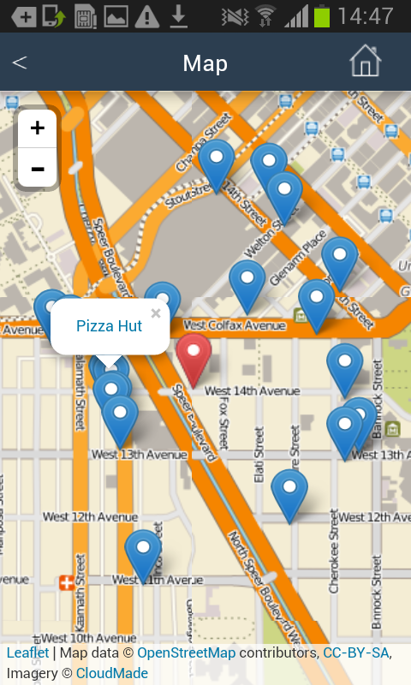

www.vnavi.com
APP
Download
VNAVI
What is location-based advertising & why is it the next big thing?
By Jack Simpson
https://econsultancy.com/blog/67418-what-is-location-based-advertising-why-is-it-the-next-big-thing/

Slide 4
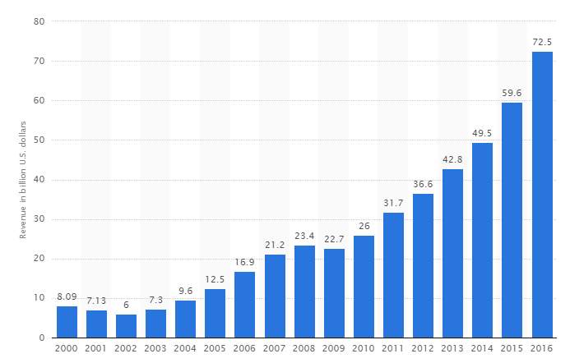
www.vnavi.com
APP
Download
VNAVI
Location-based advertising (LBA) is a new form of advertising that integrates mobile advertising with location-based services. The technology is used to pinpoint consumers location and provide location-specific advertisements on their mobile devices.
Online advertising revenue in the United States from 2000 to 2016 (in billion U.S. dollars)

Slide 5

www.vnavi.com
APP
Download
VBIKES LBA MERCHANTS
Location-based advertising (LBA) is a new form of advertising that integrates mobile advertising with location-based services. The technology is used to pinpoint consumers location and provide location-specific advertisements on their mobile devices.
Online advertising revenue in the United States from 2000 to 2016 (in billion U.S. dollars)

Slide 6
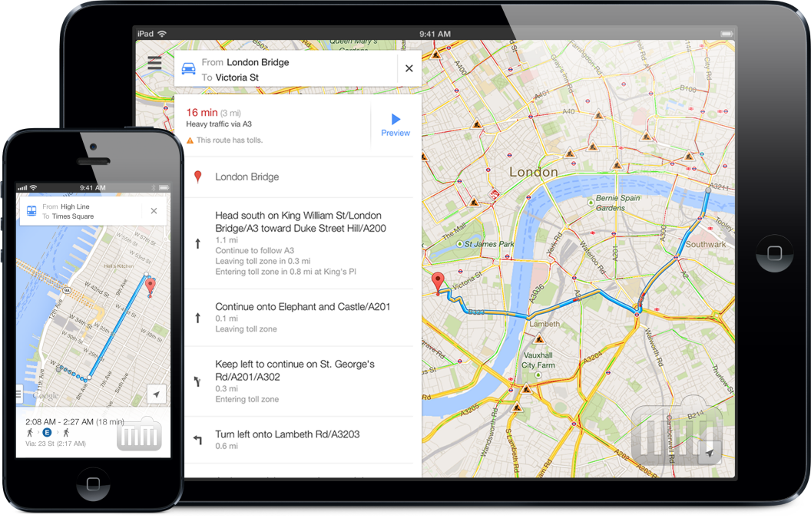
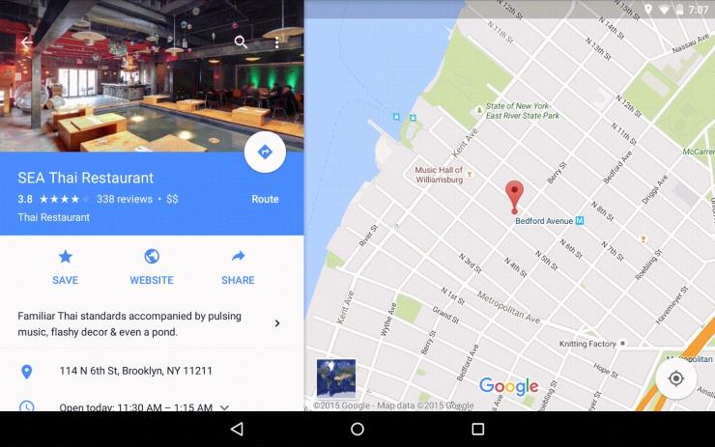

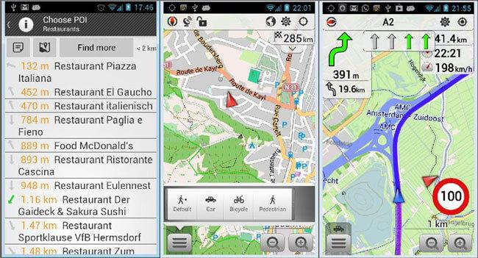
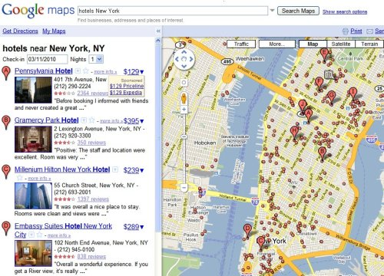
www.vnavi.com
APP
Download
VBIKES LBA MERCHANTS

Slide 7

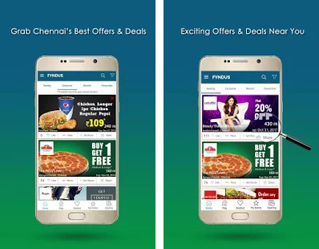
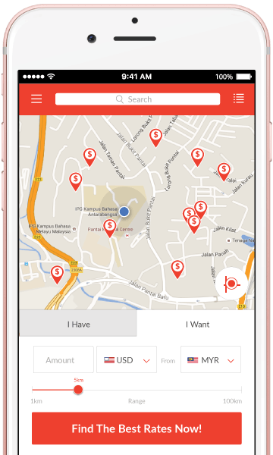
www.vnavi.com
APP
Download
EXCITING OFFERS NEAR YOU

Slide 8

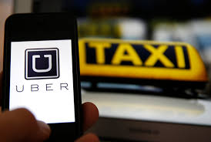
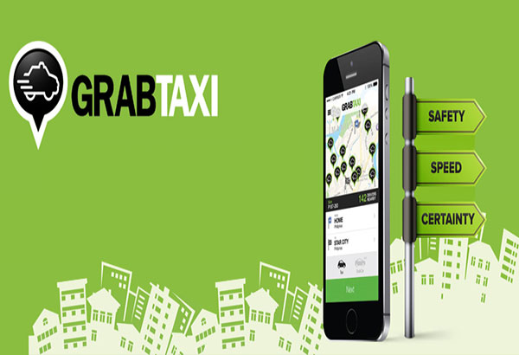
www.vnavi.com
APP
Download
VTAXI: THE NEXT E-HAIL APP
Here‘s How Much Uber Made in Revenue in 2016
Ride-hailing service Uber Technologies generated $6.5 billion in revenue last year and its gross bookings doubled to $20 billion, the ride-hailing service said on Friday.
King of the road battle in Vietnam
Ride-sharing apps Grab and Uber go head to head to dominate and redefine the fast growing country's transportation sector
GrabTaxi raises $350M to boost SE Asia operations

Slide 9

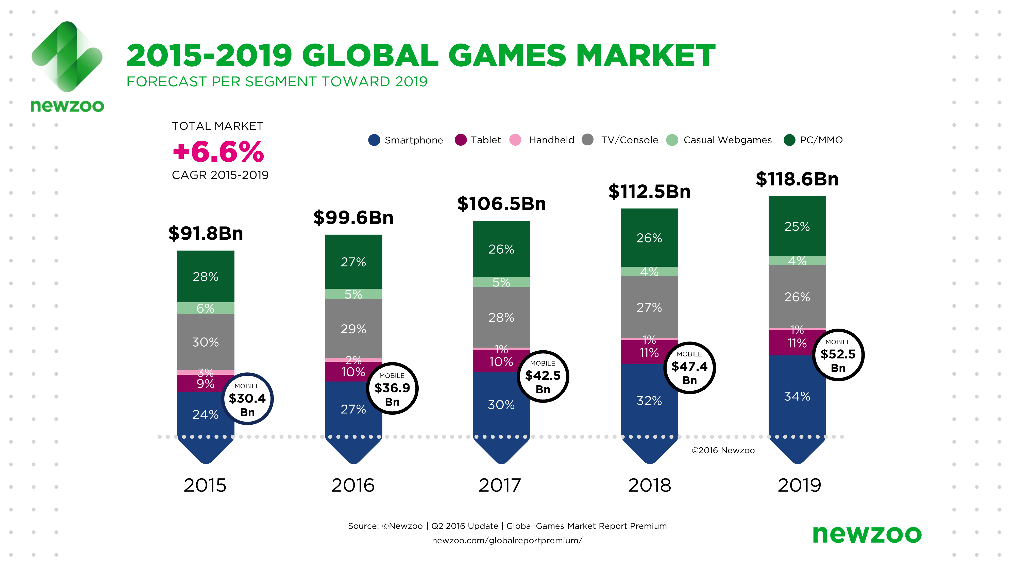
www.vnavi.com
APP
Download
VGAMES
Newzoo released the latest quarterly update of its Global Games Market Report. It shows that gamers worldwide will generate a total of $99.6 billion in revenues in 2016, up 8.5% compared to 2015. For the first time, mobile gaming will take a larger share than PC with $36.9 billion, up 21.3% globally. APAC continues to dominate worldwide, accounting for 47% of the market. China alone accounts for one-quarter of all global game revenues. Newzoo expects the global market to grow at a CAGR of +6.6% toward 2019, eventually reaching $118.6 billion with mobile gaming at $52.5 billion.
APR 21 2016

Slide 10

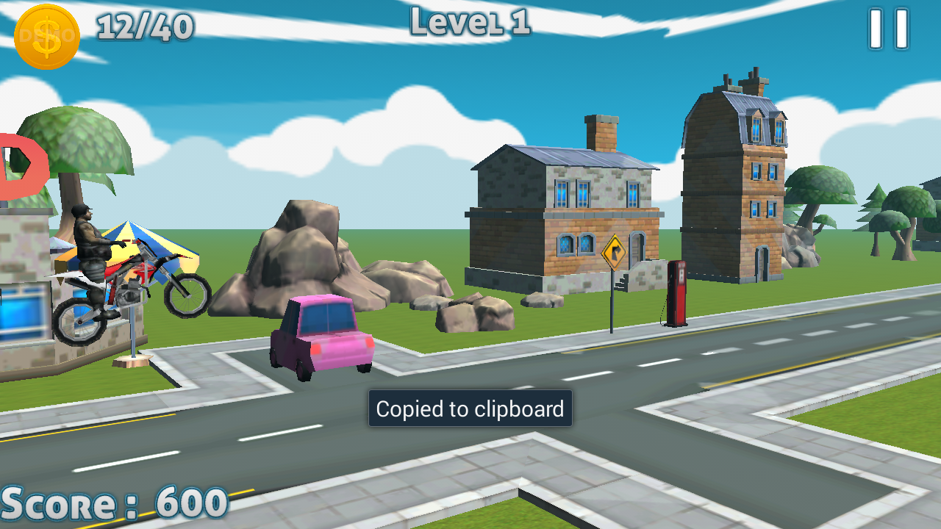
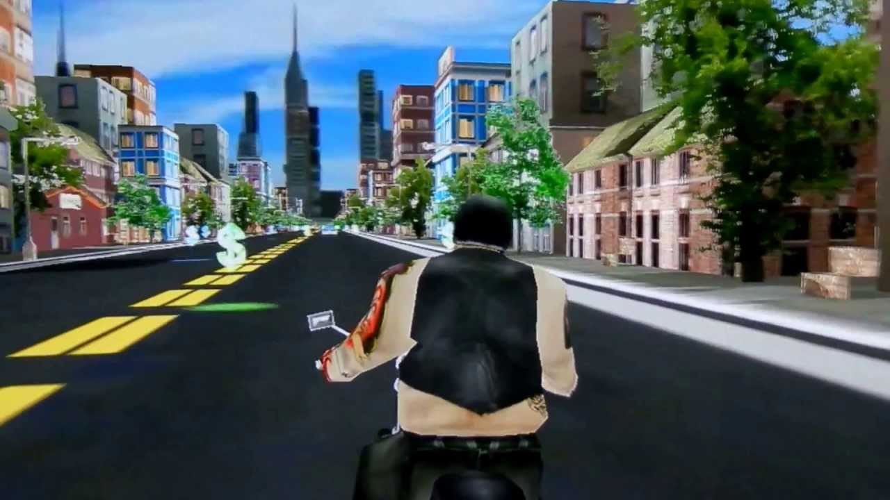

www.vnavi.com
APP
Download
VGAMES RPG GAMES FREE DOWNLOAD

Slide 11
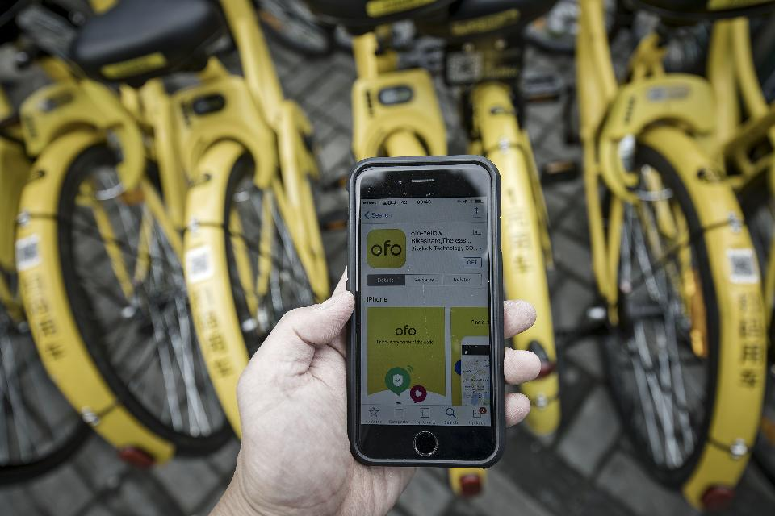
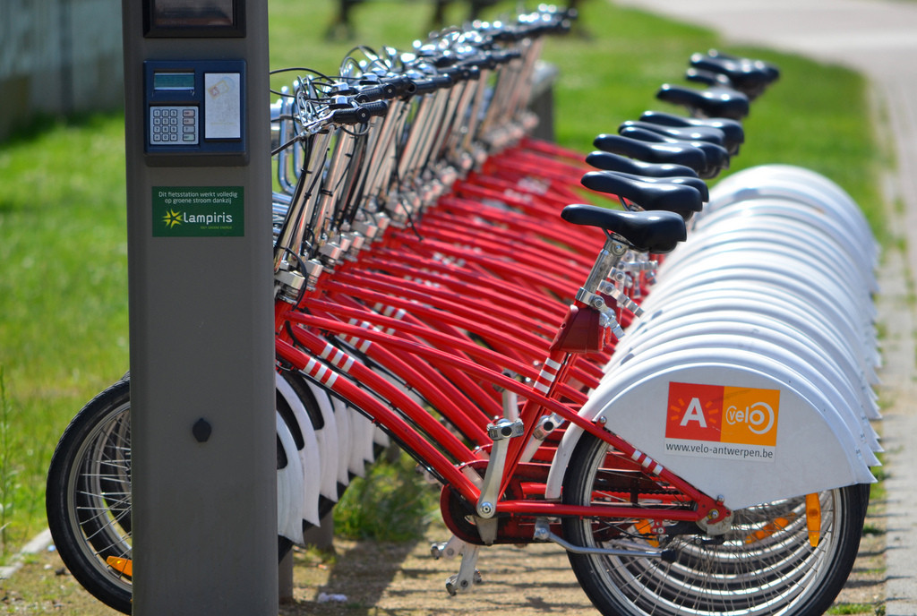
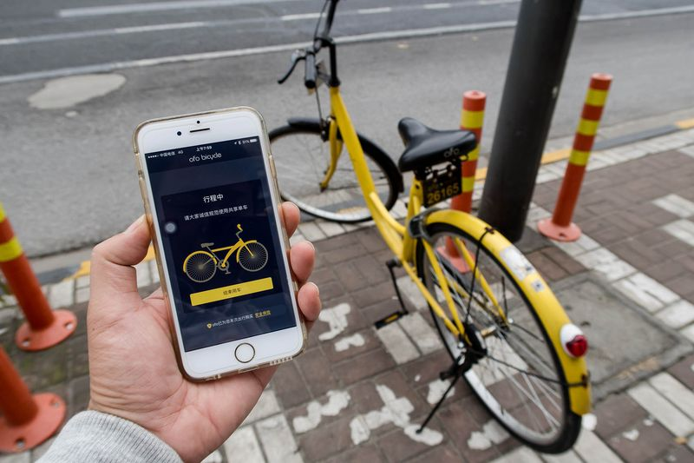
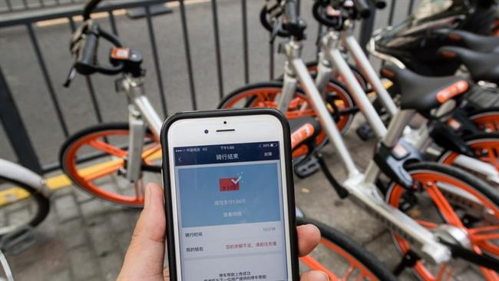
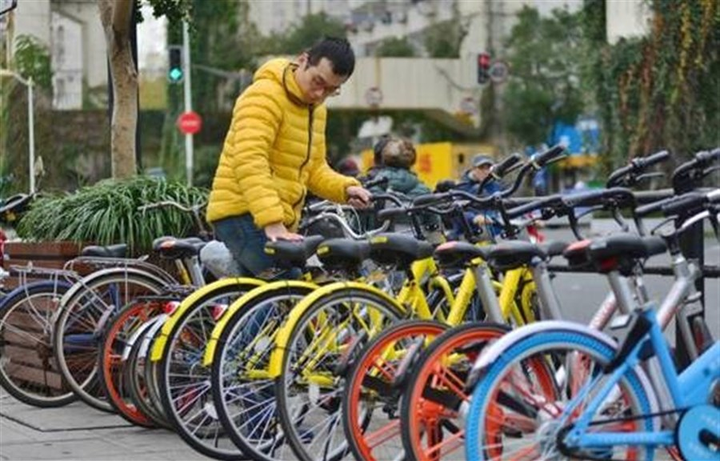
www.vnavi.com
APP
Download
VBIKES SHARING PROGRAMME

Slide 12
www.vnavi.com
APP
Download
VBIKES SHARING PROGRAMME
Implementing sustainable mobility
Bike sharing, mainly for short-duration usage, can be an efficient took in global bike policy at local level. In an effort to reduce the number of car trips made in the city, and the associated pollutant emissions, a new bike-sharing system was introduced, building on an existing bike rental scheme.
The main objectives were to:
extend the bike-sharing system to be available 24/7;
strengthen multimodality at transportation hubs;
encourage soft modes for home/school and home/work travel and travel related to leisure activities.

Slide 13
www.vnavi.com
APP
Download
VBIKES SHARING PROGRAMME
Focus more on Advertising! Why?
Income from advertising is 5 times higher than bike rental
To get people attracted
Projected Profit: at least $ 8.65 million/ year.
Ofo and Mobike are the most successful of the bike-sharing companies to date and are now valued at more than $1 billion.
They offer rides costing as little as 15 cents for 30 minutes.

Slide 14
www.vnavi.com
APP
Download
VBIKES SHARING PROGRAMME
China's Mobike raises $600 mn to fund bike-sharing expansion
(AFP News, 16/6/2017)
While the potential scale of these businesses has no doubt helped to attract investment to the tune of hundreds of millions of dollars,
the real selling point for these investors is gaining access to millions of tech-savvy customers.

Slide 15
www.vnavi.com
APP
Download
VBIKES SHARING PROGRAMME
Bike-Sharing Grows Up: New Revenue Models Turn a Nice Idea into Good Business
AUG 22, 2011 @ 01:54 PM 16,150 2 FREE Issues of Forbes

Slide 16

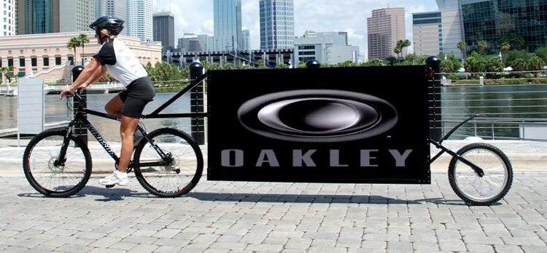
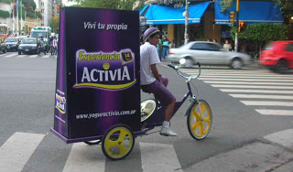
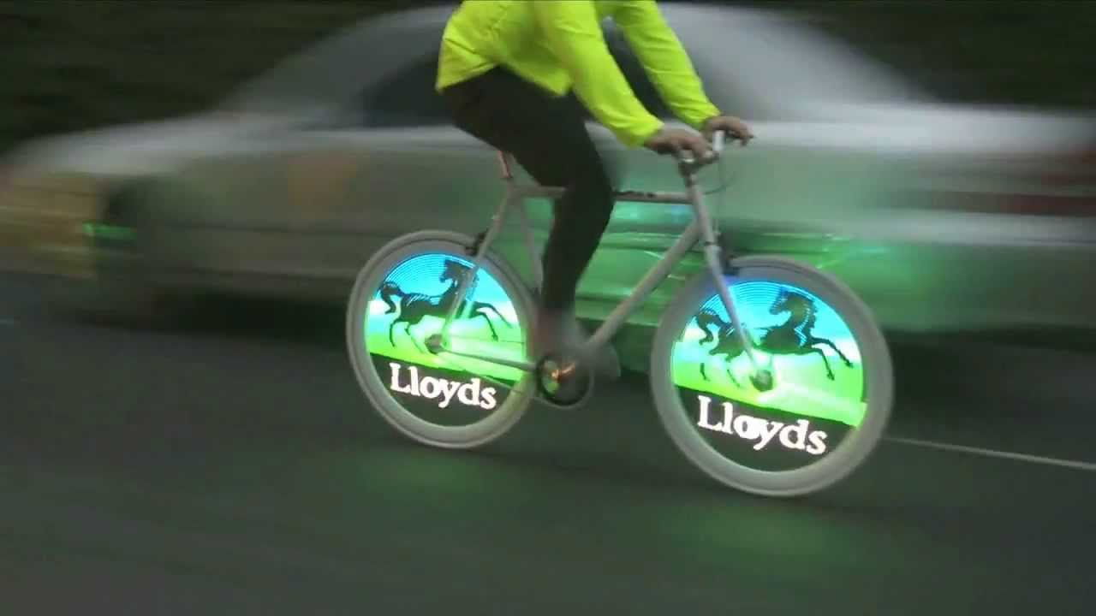
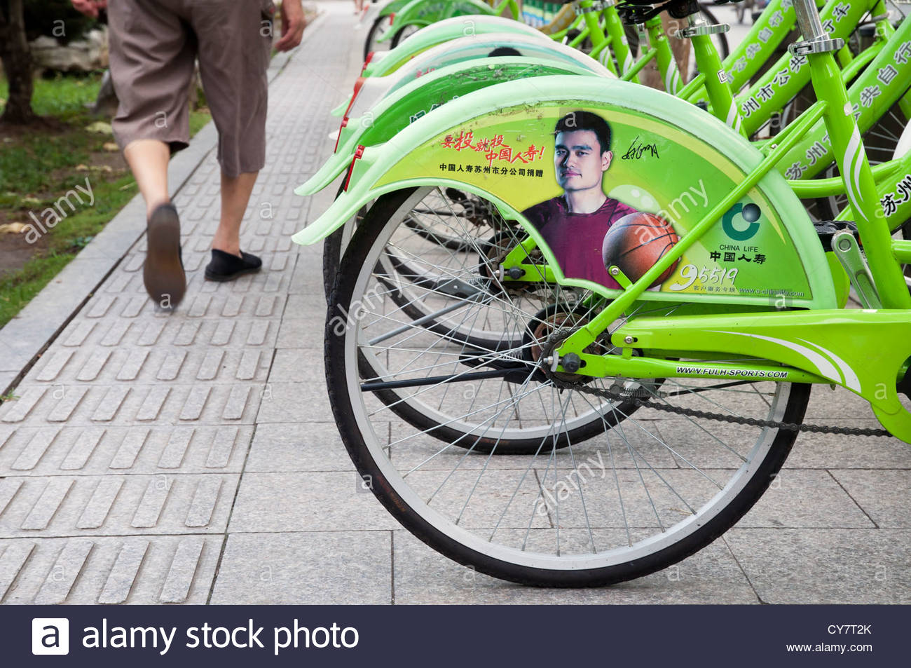
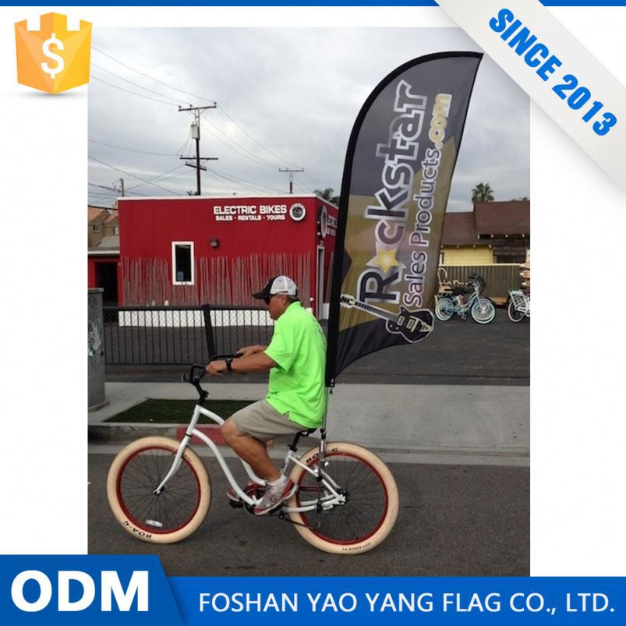
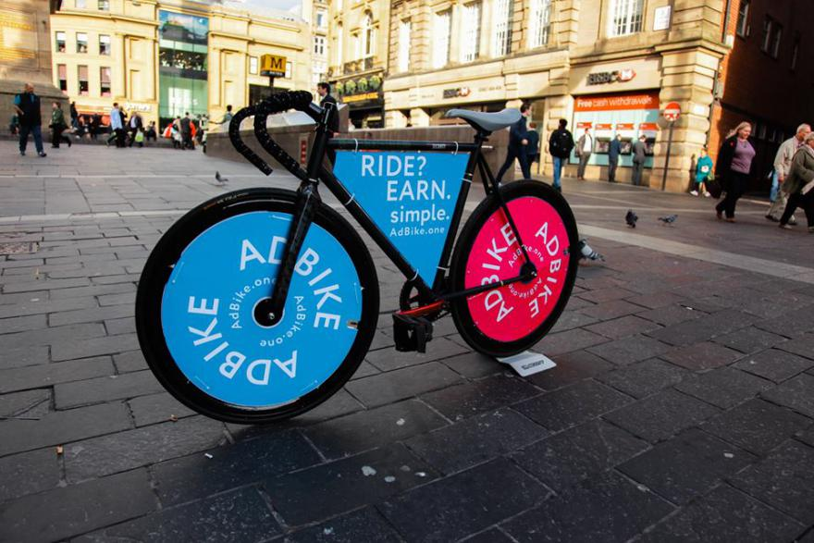
www.vnavi.com
APP
Download
VBIKES ADVERTISING

Slide 17

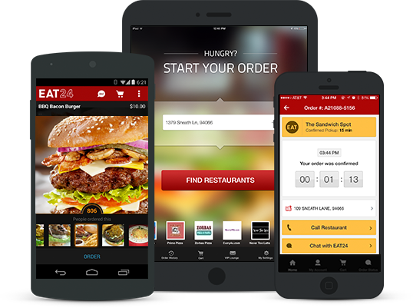
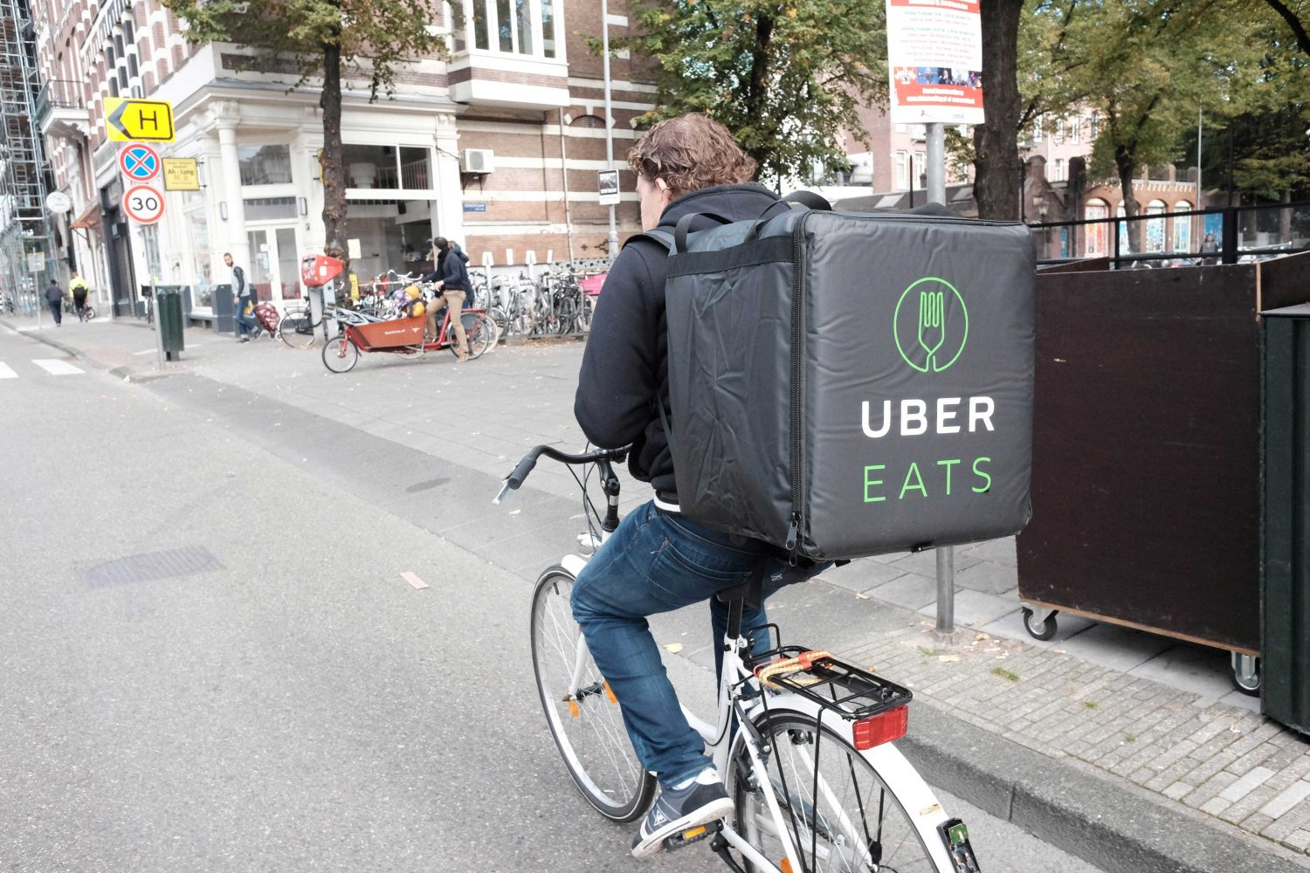

www.vnavi.com
APP
Download
VBIKES FOOD DELIVERY

Slide 18
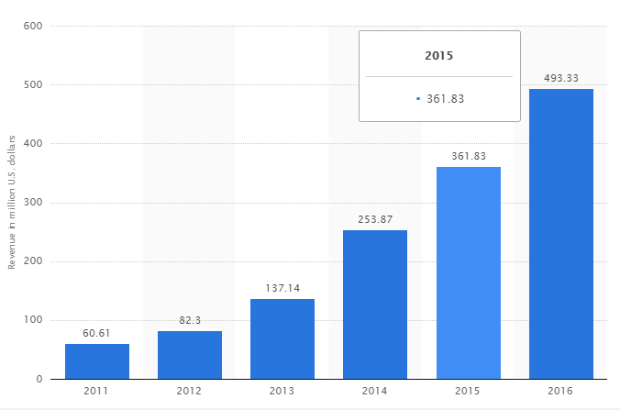
www.vnavi.com
APP
Download
VBIKES FOOD DELIVERY
Projected profit: UberEATS: Uber for Food Delivery:
1 million download worldwide by June 2017
Revenue: Nearly $500k by June 2017
Revenue of Grubhub worldwide from 2011 to 2016 (in million U.S. dollars)

Slide 19

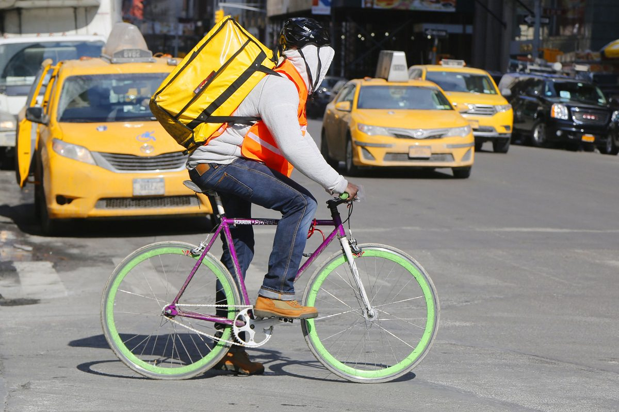
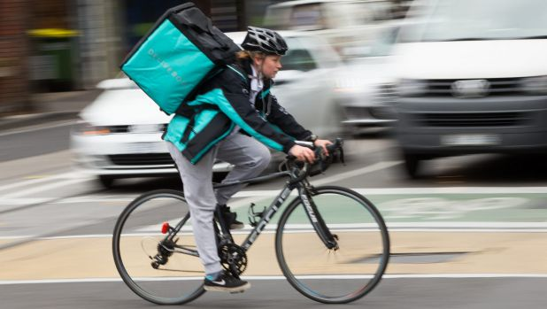
www.vnavi.com
APP
Download
VBIKES COURIER SERVICE

Slide 20



www.vnavi.com
APP
Download
VBIKES LBA MERCHANTS
We will have a new start-up division for local Vietnam courier service

Slide 21


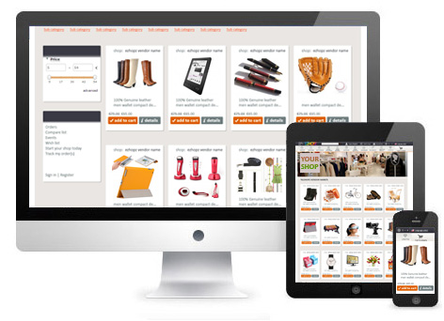
www.vnavi.com
APP
Download
VMALLS

Slide 22
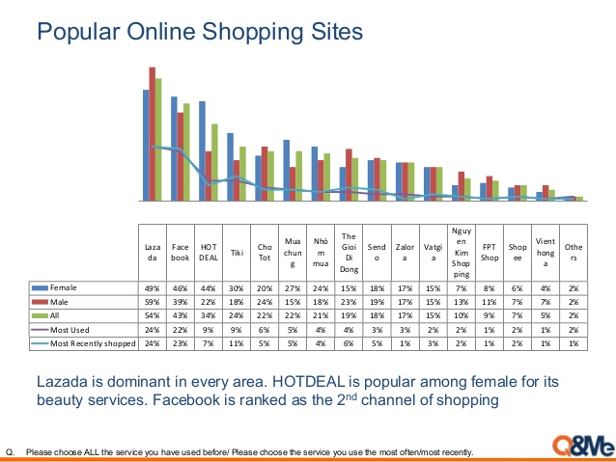
www.vnavi.com
APP
Download
VMALLS

Slide 23
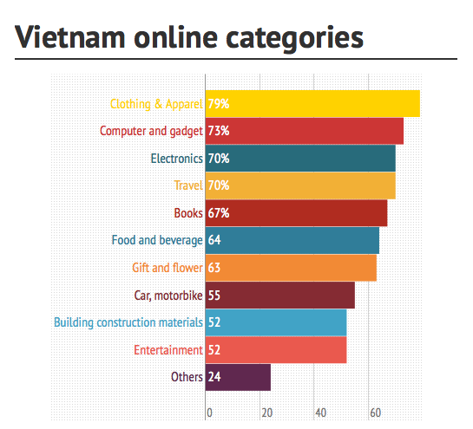
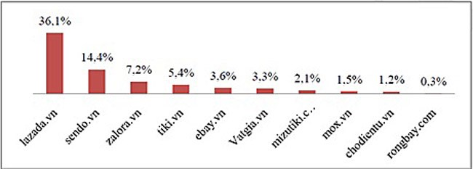
www.vnavi.com
APP
Download
VMALLS

Slide 24




www.vnavi.com
APP
Download
VPAY

Slide 25
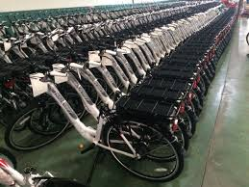
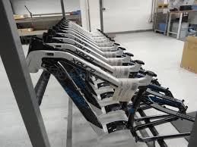
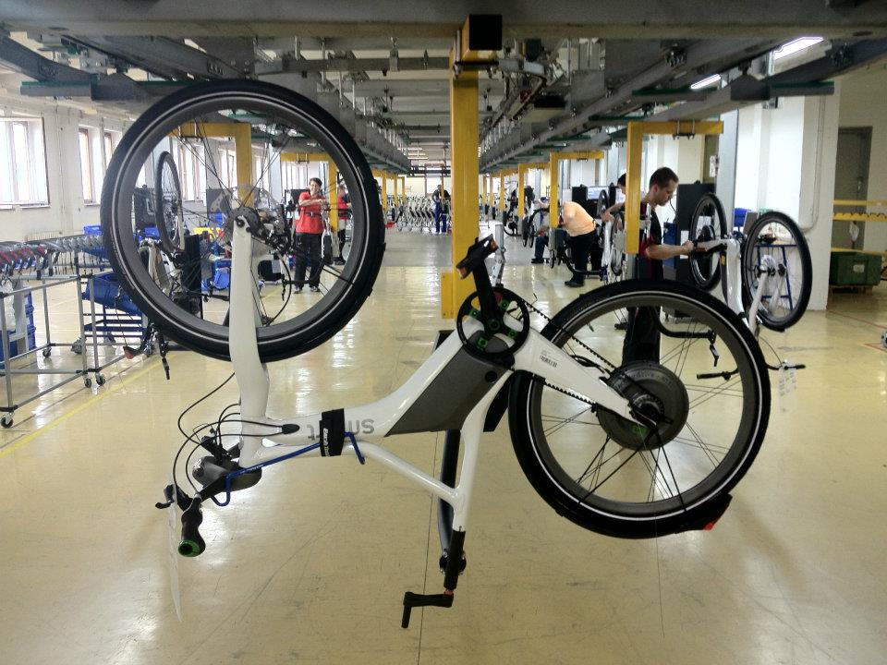
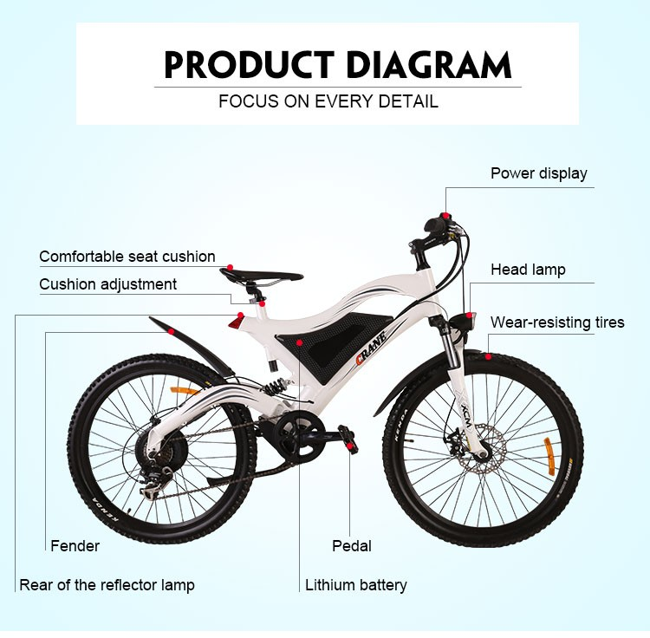
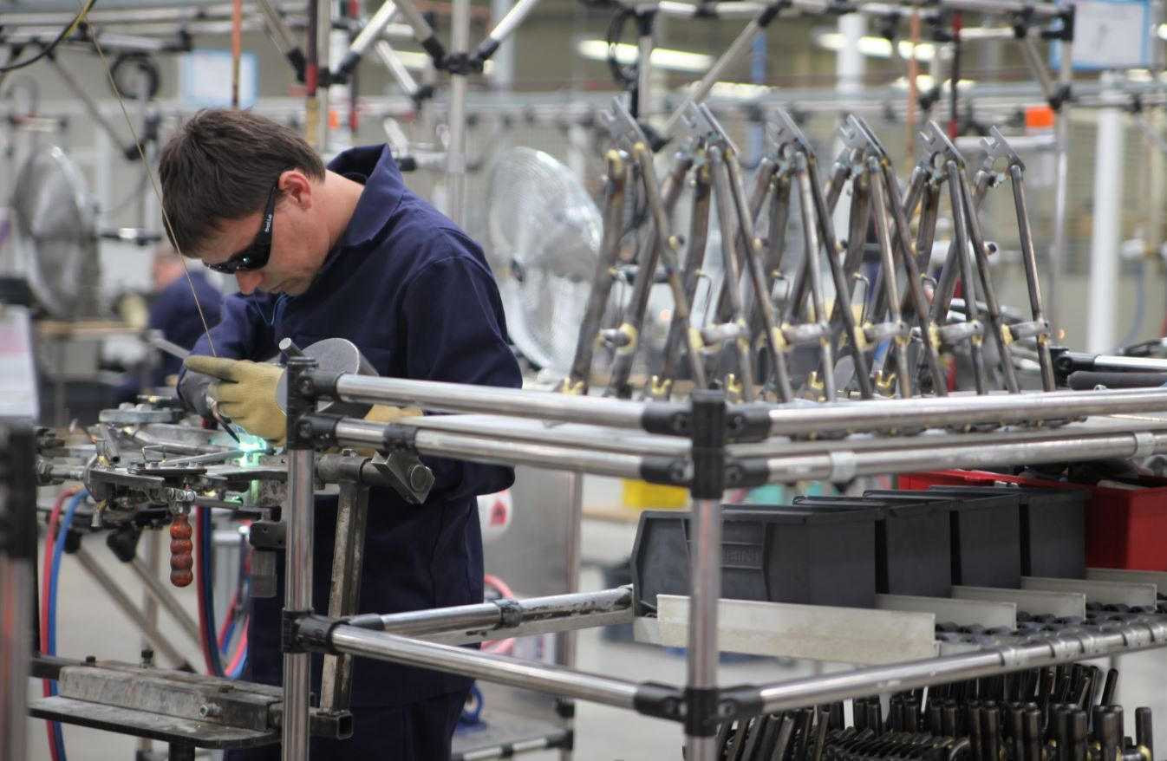
www.vnavi.com
APP
Download
VGREEN BIKE FACTORY

Slide 26
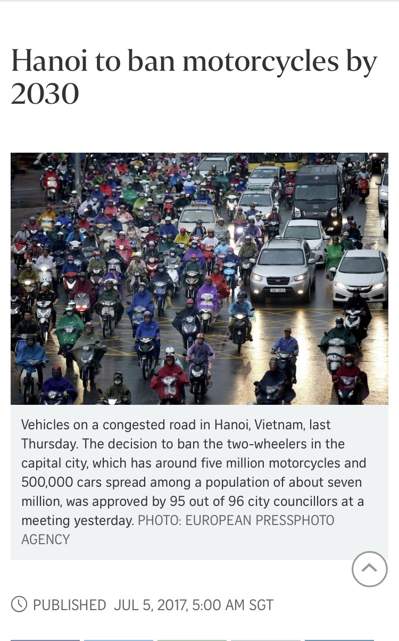
www.vnavi.com
APP
Download
VGREEN BIKE FACTORY: WHY?
Hanoi plan to ban motorbikes by 2030 to combat pollution
Create the best Vietnam-owned Green bikes
reduce pollution and traffic jam
Benefits of E-bikes
Commuting or getting around town
Cost-saving: save money on gas
Environment-friendly

Slide 27

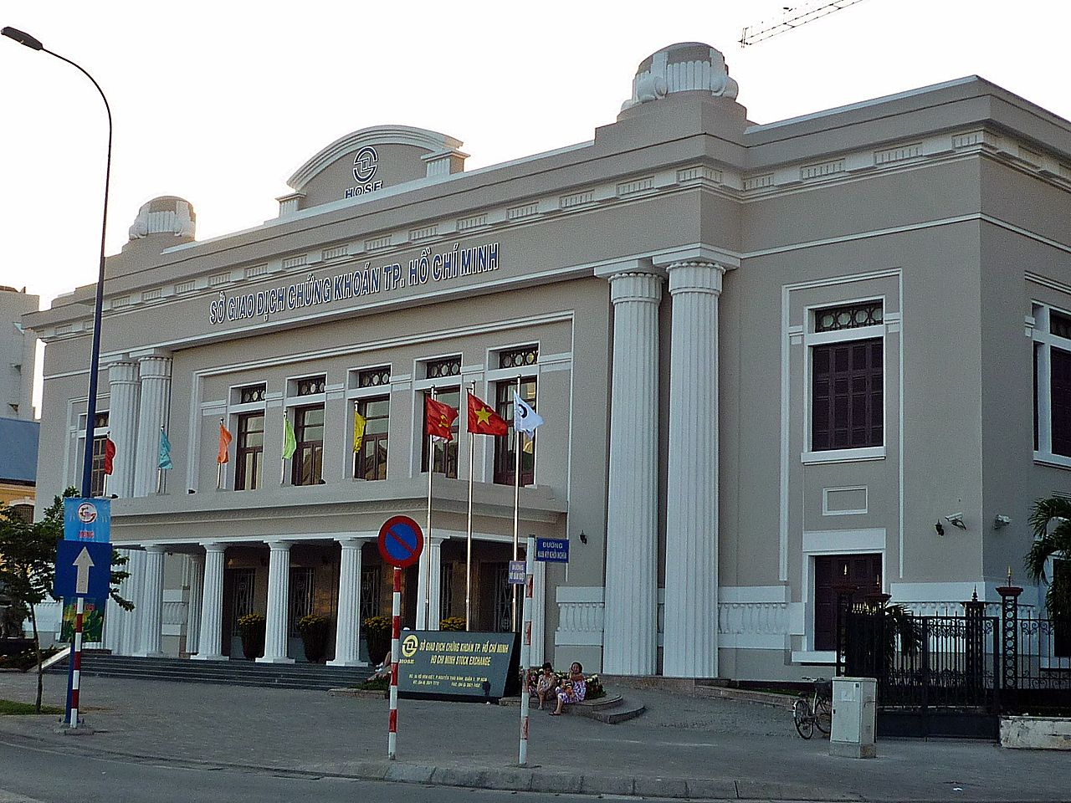


www.vnavi.com
APP
Download
VBIKES SHARE

Slide 28

www.vnavi.com
APP
Download
VBIKES CCONNECT
Hanoi HQ office address
Ho Chi Minh Office address

